Slide 1
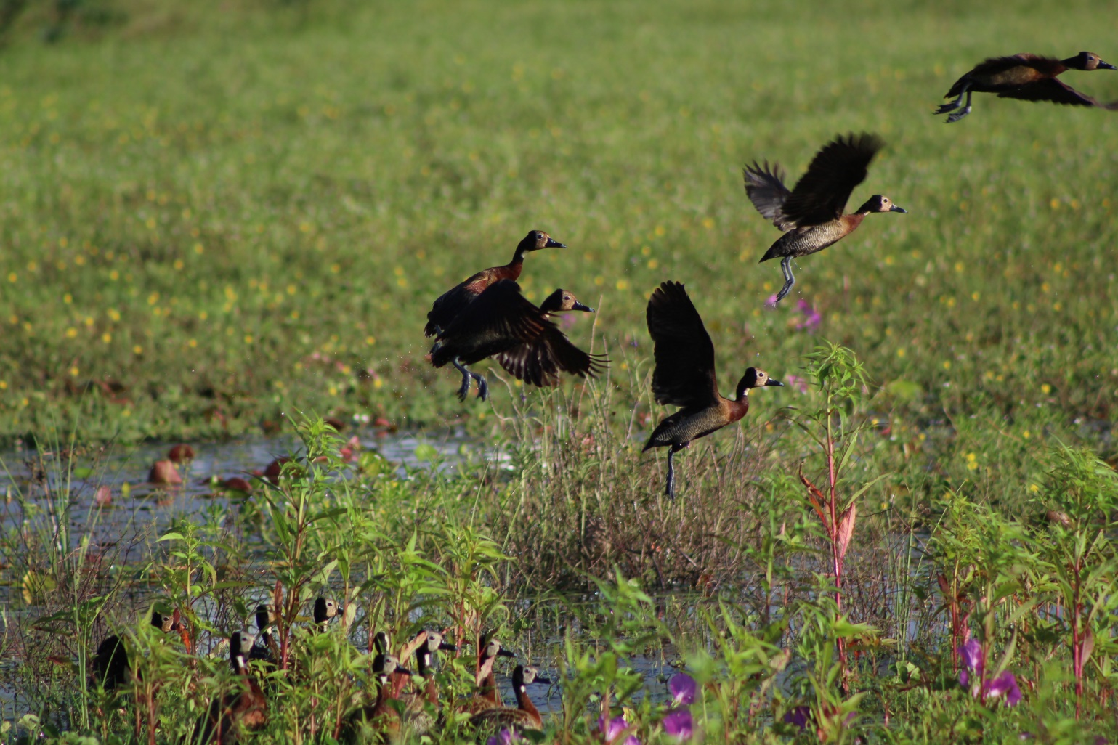







Organizers: Fernanda Alves-Martins Javier Martinez-Arribas Thainá Lessa
Workshop
Maps of Biogeographical Ignorance: a new framework to explore biodiversity data quality
Notes:
Hello everyone, thank for you participating in this workshop..
I would like to start doing a short presentation of myself and the time.
And next each one of you can do the same, saying your name, where you are from, what you do, and some else you want.
So my name is thaina, i’m biologist, phd student from brazil, since my graduation i’m working with shortfalls on biodiversity knowledge.
I like to make maps with biological records and try to undersant gaps and trends in collect effort. In my pdh i’m working in african context.
...
So our workshop is pratical but we will start with a overview about biodiversity data and data quality. If you have some question during presentation you can ask.

Slide 2
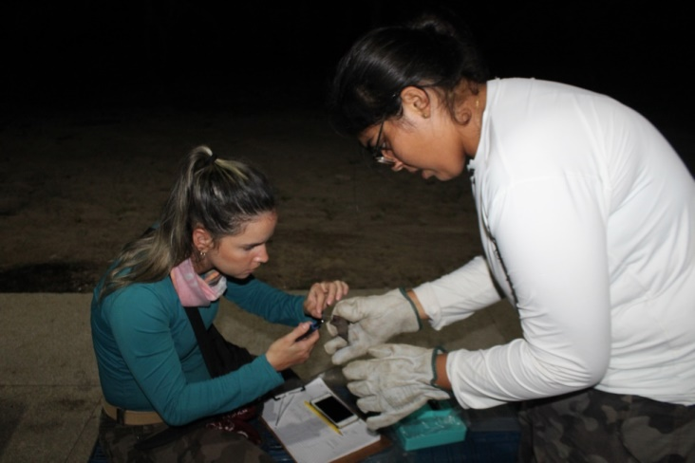



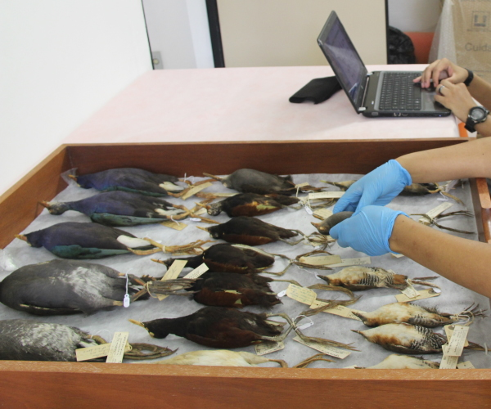


Biodiversity Data
Field Work > Museum/Herbaria > Online databases
Notes:
When we are talking about biodiversity data, we have some types of data..
For examples, from field work or museum and herbaria…
After modernization of systems.. Now researchers can collect data from online databases, as gbif, ebird, catalogue of life and other.
The choice of the type of data used in each study depends on:
– (a) the quality and quantity of available data
– (b) the purpose of the study

Slide 3




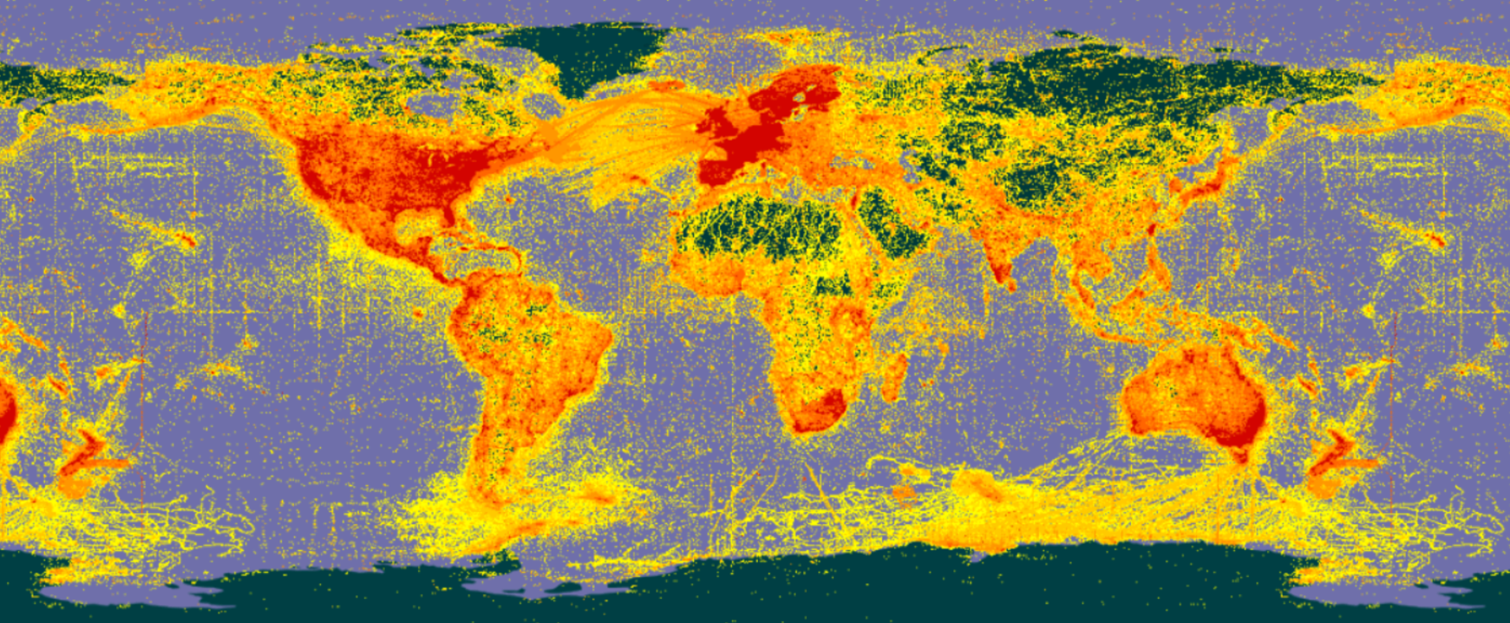
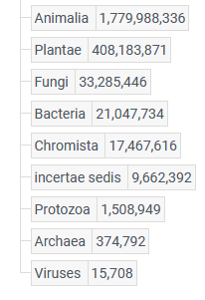
Global Biodiversity Information Facility
Largest collection of biodiversity data globally
+ 2 billion
Records
+ 8 thousand Institutions
www.gbif.org; 26/06/2023; CODATA, 2020
Notes:
The most important globally project for sharing data is GBIF. This platform holds more tem 2 bilion records of biodiversity since vertebrates to virus, covering amost all the world.. And the data available is from more than 8 thousand institutions, that can be a museum or na online database.

Slide 4
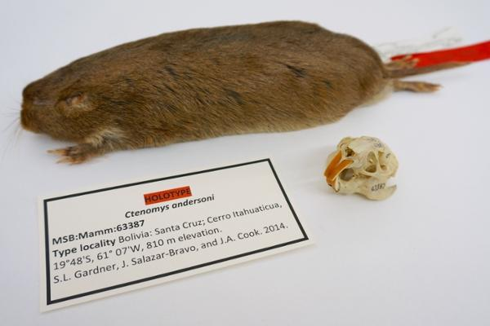
Which information is important?
Scientific name
Date
Space
Collectors
Notes:
Talking about conservation or biogeographic studies of animals and plants, we it is necessary use a couple of informations.
As example in this voucher.. Its importante that we know what is the specimen (name), when and where it was collect, who have collect.. And another ones, elevation, type of specimen..

Slide 5
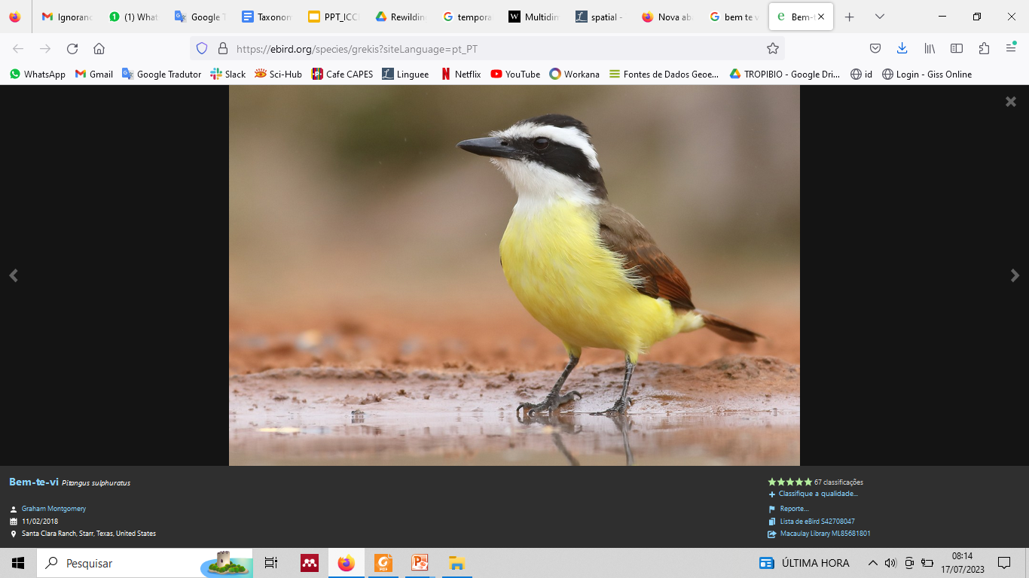
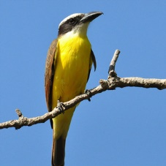
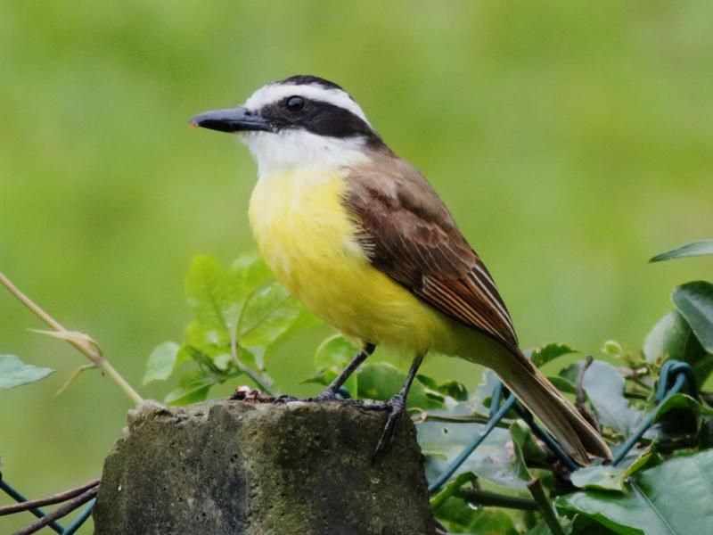
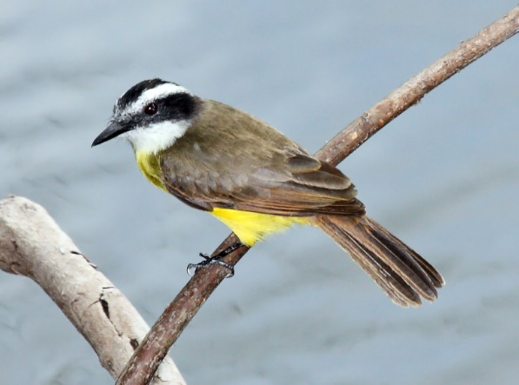
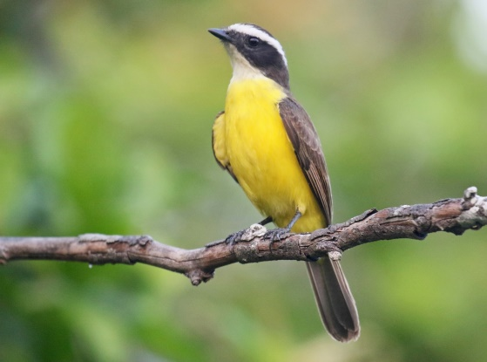
Issues associated to biodiversity data
Notes:
But we have some issus associated to biodiveristy data, even from museum or online platforms..
I brought this example.. This is a popular bird in brasil, called bem-te-vi... But as we can see, this collector put the name, the year, but did not put de coordinates, so this records could not be used for make species distribuition models, for example..
And another problem associated is some species as Bem-te-vi is very similar to anothers one.. In the field we can confuse about which species is, if we are working with criptic species.. So know about who have collect is important for we estimated is the taxonomy is correct or some errors could be associated.

Slide 6
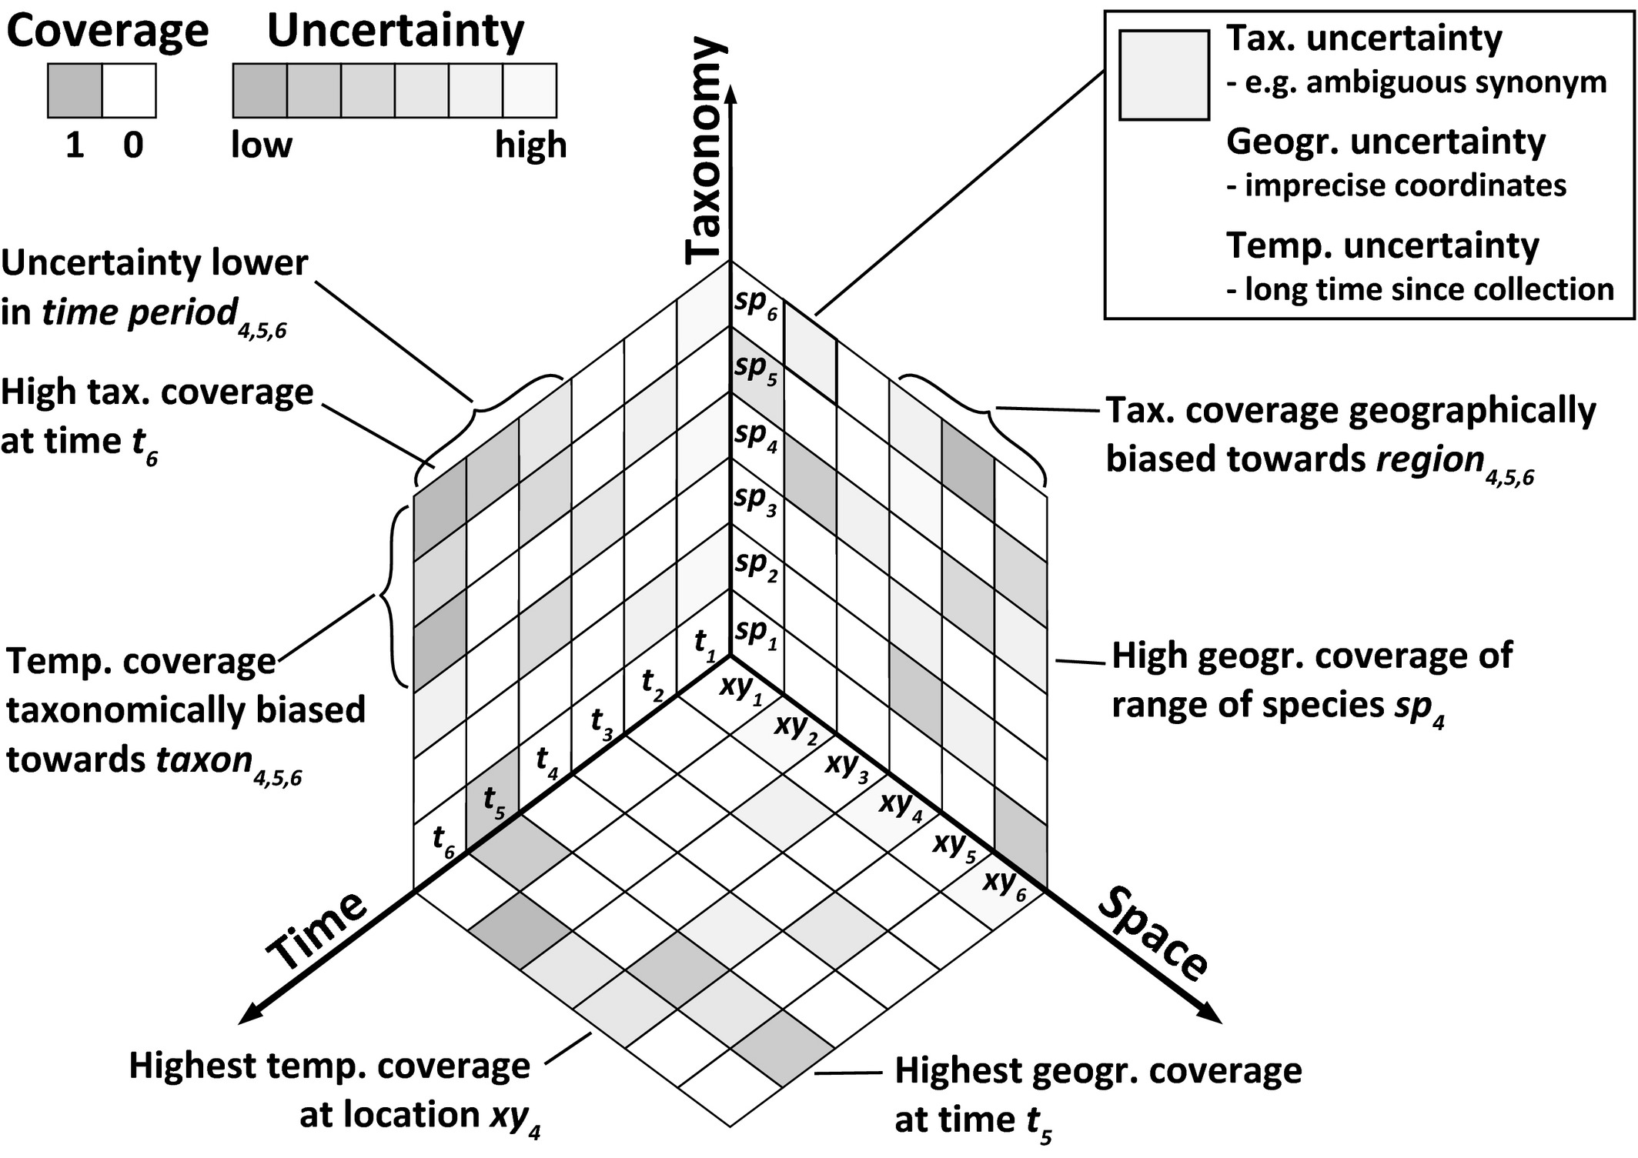
Multidimensional biases, gaps and uncertainties
Meyer et al. (2016) Ecol Lett .
Notes:
Meyer and colleagues made a framework for analysing limitations in occurrence information along taxonomic, geographical and temporal dimensions.
Occurrence records cover different species (sp1, sp2, . . .) in different locations (xy1, xy2, . . .) and different points in time (t1, t2, . . .).
Applicability of occurrence records depends on: (1) coverage of the three dimensions with information (grey cells), and (2) uncertainty associated.
Thus, a cell may be covered, but uncertainty of the records may vary from low (dark grey) to high (light grey);
White cells indicate no coverage with available information.

Slide 7
Biases and gaps in biodiversity data
Taxonomic:
Some species receive more attention, study, investment than others
Incorrect or incomplete taxonomic identification
Spatial:
Some regions/biomes are better sampled than others
Accessibility, previously sampled, proximity to research centers…
Temporal:
Habitat degradation, land cover and climate change
Modify species assemblages
Impossible to retry samples

Slide 8
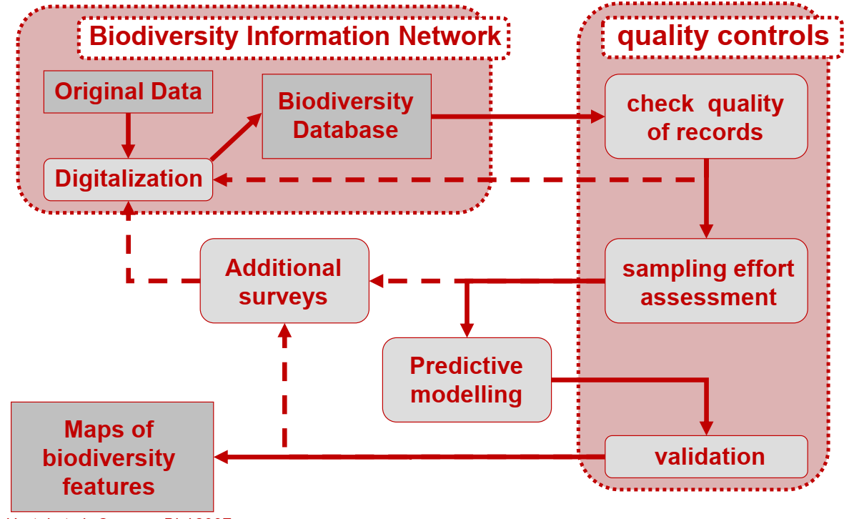
Quality of biodiversity data: degree of congruency between recorded data and
current conditions that the historical data represents
Taxonomic , Spatial, Temporal
Meyer et al. (2016) Ecol Lett; Hortal et al (2007) Conserv Biol
Notes:
The quality of biodiversity data—that is, the degree of congruency between recorded data and current conditions that the historical data represents—is a central issue for global monitoring and assessment. It influences the accuracy of our descriptions of historical and contemporary patterns, determining our ability to provide realistic models of the future impacts of environmental change.
This is a protocol made by Hortal et al to obtain reliable maps of biodiversity variables from biodiversity databases. So we need colect the data from original data or biodiversity database such as gbif, after we need assess data quality in term of taxonomy, space and time, and we need evaluated if the sampling effort is useful your maps.

Slide 9
How to map gaps and measure data quality ?
Ignorance Score
Based on raw data
No minimum N. records
No estimations
Three algorithms
0: low ignorance
1: high ignorance
N. records
N. maximum records
IS:
Completeness
Based on accumulation curves
Minimum N. records
Number of species is estimated
0: incomplete
1: complete
N. Species obs
N. Species exp
C:
MoBIs
Based on multiple data
Minimum N. records
0: low ignorance
1: high ignorance
Completeness
+ Taxonomic quality
+ Temporal decay
BI:
Notes:
In this course we will talk about ways to assess data quality and sampling effort.
There are severals methods to do it.
But we will talk about our experiences working with these three types of scores and maps. That can be interpretated as more simple to more improved.
The first one is ignorance score..
Completeness
And finally maps of biogeography ignorance

Slide 10
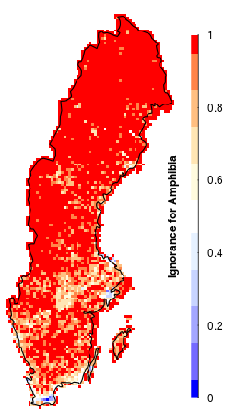
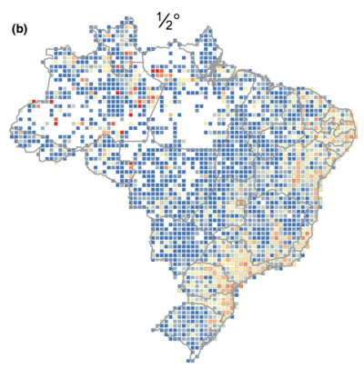
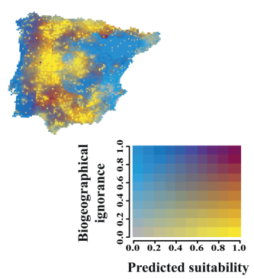
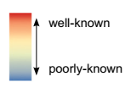



How to map gaps and measure data quality ?
Ignorance Score
Completeness
MoBIs
Ruete (2015)
Biodivers. Data J.
Souza-Baena et. al. (2014)
Divers. Distrib.
Tessarolo et. al. (2021)
Ecography
Notes:
All of them results in maps with a scale..
And we can see and analyse areas with low to high effort and quality.

Slide 11

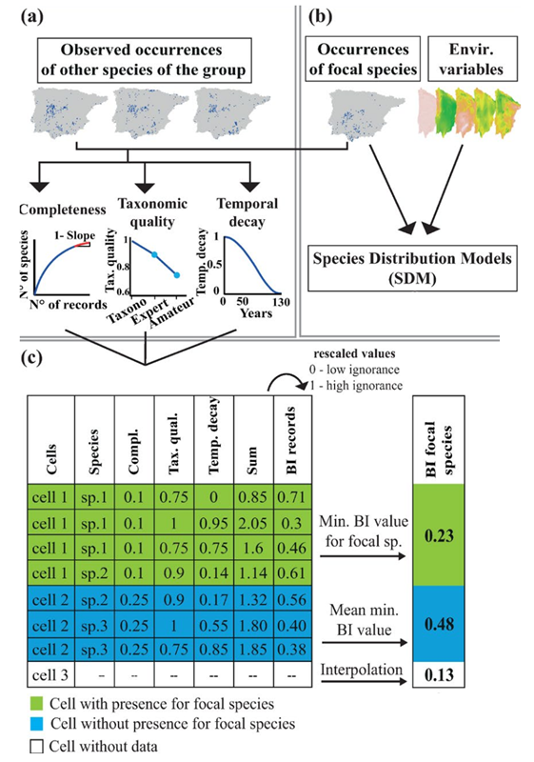
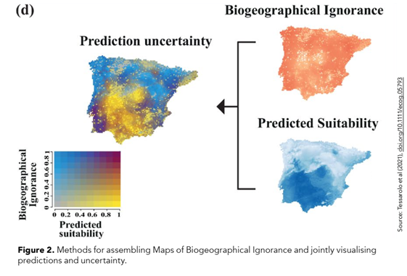
Notes:
Now we will focus in the components of mobis..
That is completeness that I presented.
And taxonomy quality and temporal decay..

Slide 12


Taxonomic uncertainty
Ideal World
Real World
New species
Collected
Nominated
Allocated to a branch
Universal species concept
New species
Several collectors
Several methods and concepts
Taxonomic changes
Notes:
Em um mundo ideal, cada espécie recém-descrita teria sido meticulosamente documentada, identificada de forma inequívoca, nomeada e alocada definitiva e permanentemente um ramo único na árvore da vida usando métodos idênticos baseados em um conceito único e universalmente aplicado do que constitui uma espécie.
No mundo real, os taxonomistas têm usado (e continuam a usar) uma variedade de conceitos de espécies e métodos de delimitação (Zachos, 2016, 2018b) para identificar novas espécies e reavaliar espécies já documentadas, sendo extremamente comum em alguns grupos para que os táxons politípicos sejam divididos, criando uma ou mais espécies novas, ou para que espécies intimamente relacionadas sejam reclassificadas como uma única espécie (conhecida como 'aglomerado');
Muitas dessas mudanças devem-se aos avanços nos métodos moleculares e computacionais, combinados com um grande número de conceitos de espécies concorrentes lutando pelo domínio (Kitchener et al., 2022; Zachos, 2018b);

Slide 13
Taxonomic uncertainty
Taxonomic error
Probability increases with...
multiple alternative taxonomies
number of synonyms
recentness of revision (split or lump)
unresolved taxa (species complex)
Identification error
Probability increases with…
expertise of recorder (amateur vs specialist)
remote samples (observations vs specimens)
less well studied groups
more recent taxa
the result of either error is the same, it does not represent the stated species
Notes:
The taxonomic uncertainty has two kinds of errors associated..
One regarding taxonomic and other identification..

Slide 14
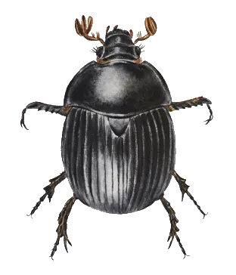
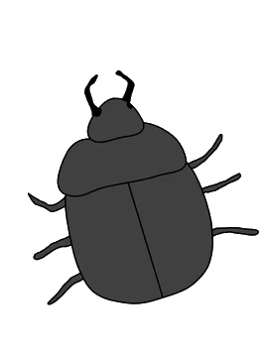
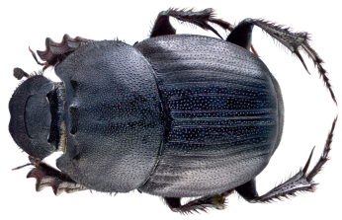
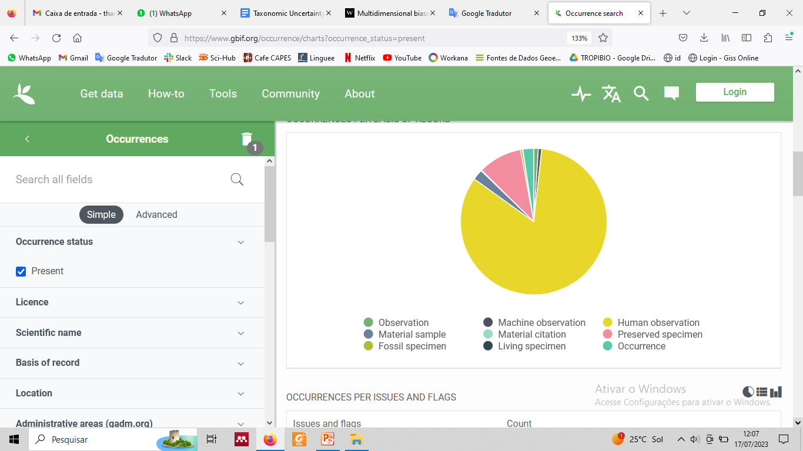
Identification errors
Level of taxonomic expertise and training
Type of data
Taxonomists Experts Amateurs
Isaac & Purvis (2004) Divers Distrib
Notes:
Is still dificult analyse taxonomic uncertainty..
And literature often refers this errors as associated with who is identifying the speciems..
So taxonomist trends to identify with high quality than amateurs..
And this errors is associated with type of data.. As we can see in graphic.. The most of gbif data is from human observation, for examples birdwatchers or wildlife photographers, sometimes with no experience or training.

Slide 15
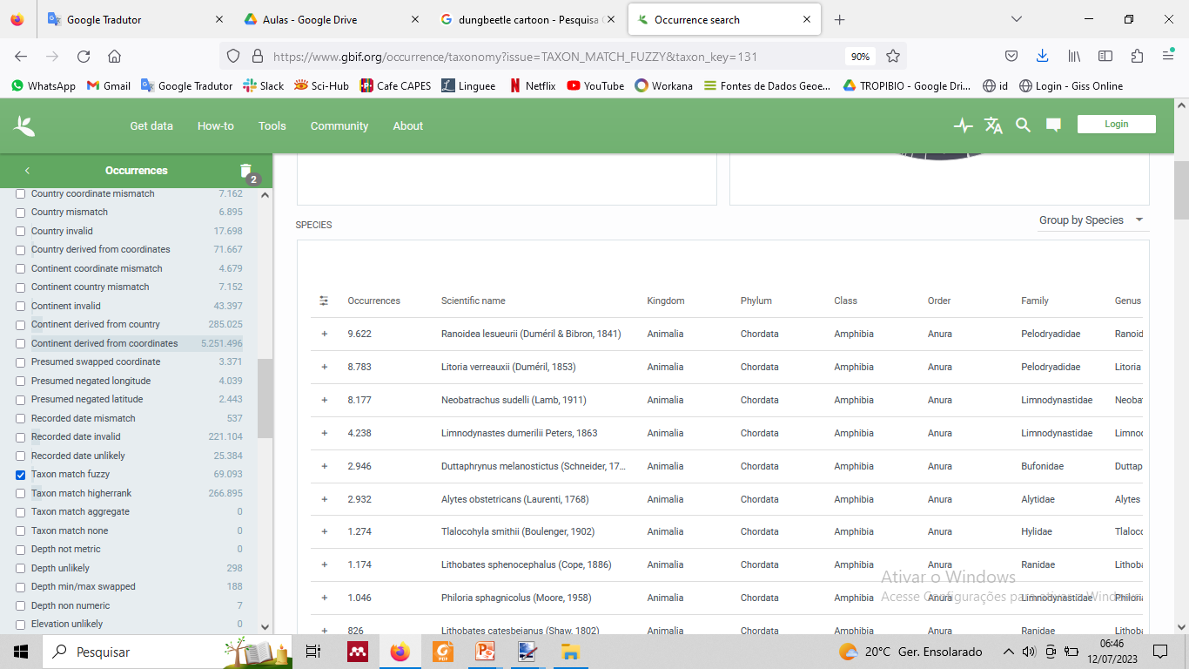
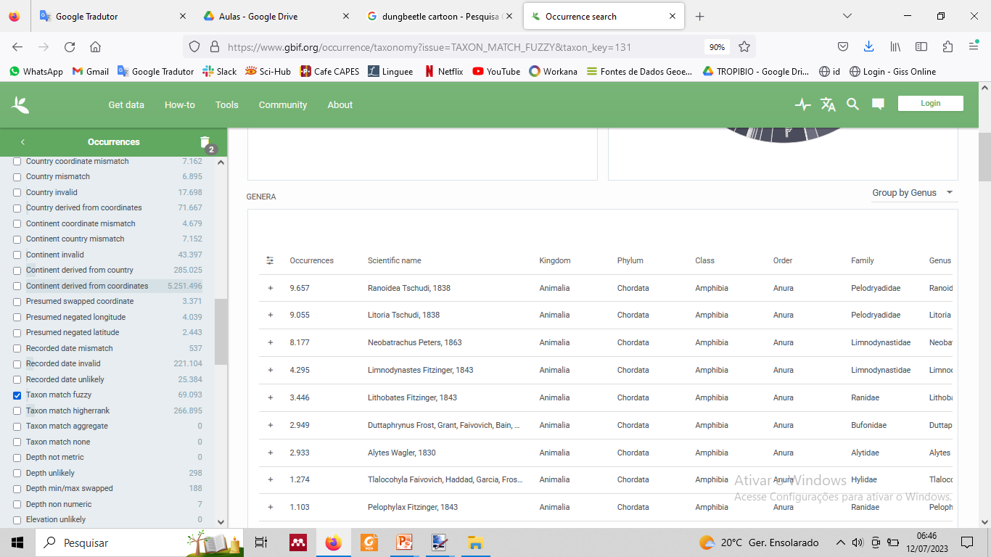
Identification errors
Identification level
lowest taxonomic level (i.e., species or subspecies)
higher taxonomic levels (i.e., genus, family, order, etc.)
Notes:
A way to measure the accuracy of taxonomic identifications is to verifying if the specimen has been identified at the lowest taxonomic level (i.e., species or subspecies), rather than at higher taxonomic levels (i.e., genus, family, order, etc…)

Slide 16
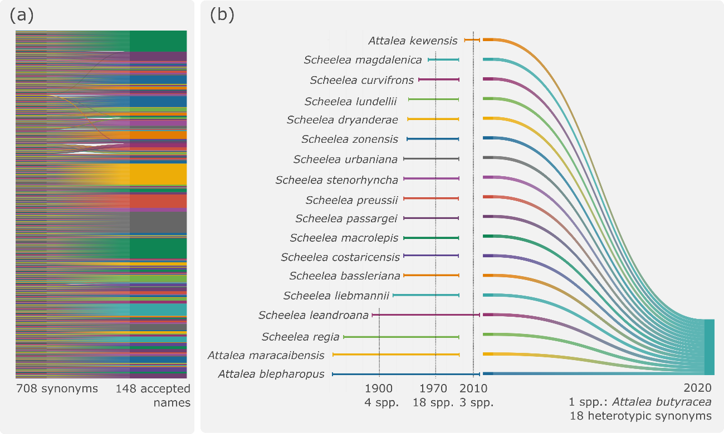
Temporal Decay
Processes that driven temporal decay
Periodic taxonomic revisions
Splitting and lumping
Tessarolo et al. (2017) Ecol Evol

Slide 17
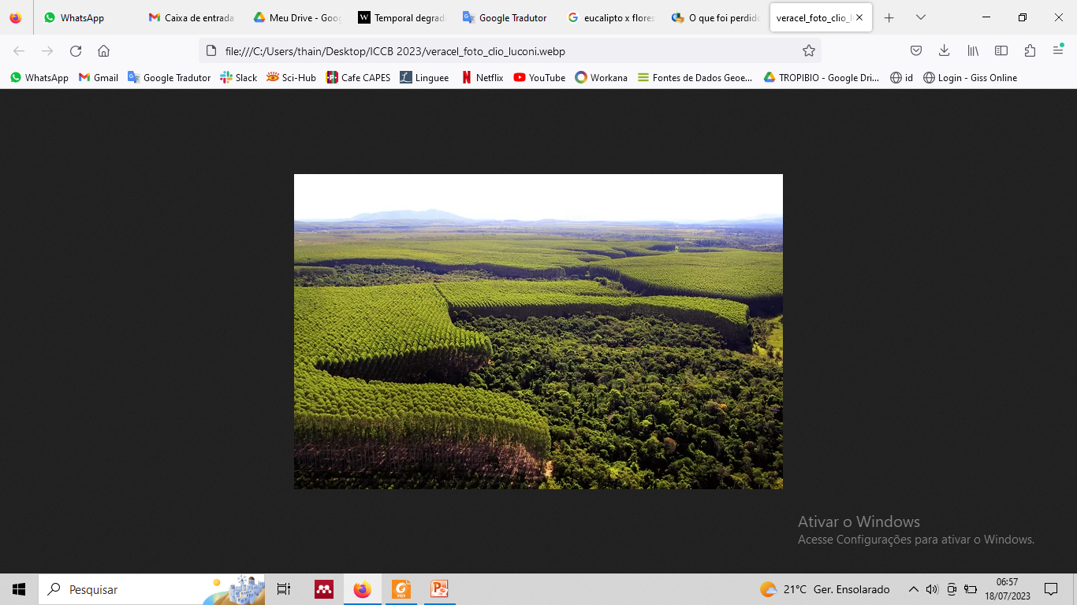
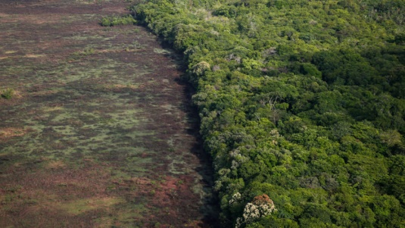

Temporal Decay
Processes that driven temporal decay
Natural dynamics of ecological systems
Local extinction, invasions, immigration
Habitat degradation
Deforestation, land cover and climate change
Loss of physical data
Inefficient curation or accidents
Tessarolo et al. (2017) Ecol Evol

Slide 18
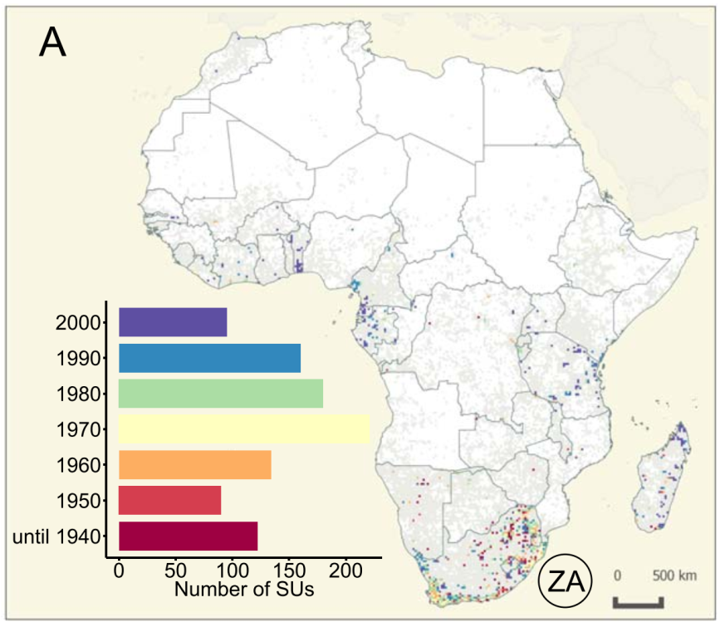
Temporal Decay
Stropp et al. (2016) - Glob Ecol Biog
Completeness of African Plants
31% of cell (25 km x 25km) contained at
least one specimen
2.4% contained a sufficient number of records
(≥50) to estimate inventory completeness.
Temporal bias towards old specimens in
South Africa (that holds 50% of the available
data for the continent).
Notes:
This is despite many of our databases contain a high proportion of old records. The scale of this problem is well illustrated by the analysis of GBIF data on African flowering plants, that Stropp et al. (2016) found that the majority of well surveyed cells contained predominantly old records and were in urgent need of re-sampling

Slide 19
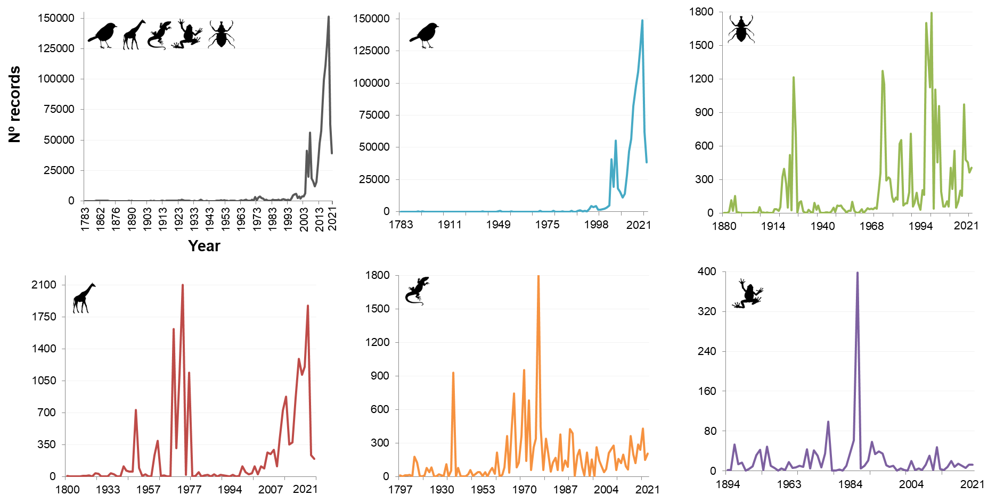
Temporal Decay
Lessa & Alves-Martins (2023) in revision
Notes:
We found a simmilar pattern in Namibian data.

Slide 20
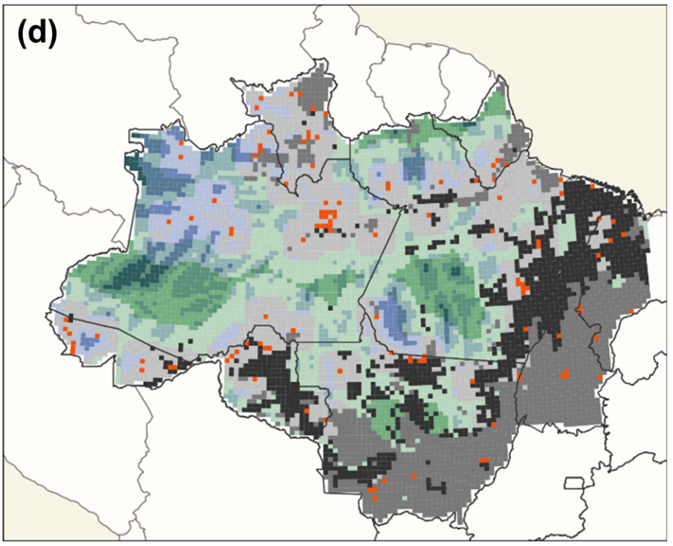
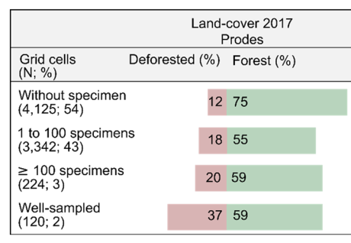
Temporal Decay
Stropp et al. (2020) - Ecography
Completeness of Amazon Plantas and Deforestation
Stropp et al. (2020) Ecography
Notes:
They found that by 2017, 12% of the Brazilian Amazon had been deforested, without having a single tree specimen recorded. And 37% of areas well sampled were deforested.

Slide 21
Using only one metric may be insufficient to communicate the many shortcomings inherent to species-occurrence data (Hortal et al., 2015). Thank you! ¡Gracias! Obrigado!
Fernanda Martins - ferfealvesmartins@gmail.com Javier Martínez - javimartinezarribas@gmail.com Thainá Lessa - thainalessaps@gmail.com

Slide 22
References
Hortal, J., de Bello, F., Diniz-Filho, J. A. F., Lewinsohn, T. M., Lobo, J. M., & Ladle, R. J. (2015). Seven Shortfalls that Beset Large-Scale Knowledge of Biodiversity. Annual Review of Ecology, Evolution, and Systematics.
Lessa, T., dos Santos, J. W., Correia, R. A., Ladle, R. J., & Malhado, A. C. M. (2019). Known unknowns: Filling the gaps in scientific knowledge production in the Caatinga. PLoS ONE.
Ladle, R. J., & Whittaker, R. J. (2011). Conservation Biogeography. In Conservation Biogeography.
Parsons, D. J., Pelletier, T. A., Wieringa, J. G., Duckett, D. J., & Carstens, B. C. (2022). Analysis of biodiversity data suggests that mammal species are hidden in predictable places. Proceedings of the National Academy of Sciences.
Stropp, J., Ladle, Richard. J., Emilio, T., Lessa, T., & Hortal, J. (2022). Taxonomic uncertainty and the challenge of estimating global species richness. Journal of Biogeography, In Press
Ubirajara O., et al. (2016). The strong influence of collection bias on biodiversity knowledge shortfalls of Brazilian terrestrial biodiversity. Diversity and Distributions.
Troudet J., et al. (2017). Taxonomic bias in biodiversity data and societal preferences. Nature, Scientific Reports.
Da Silva FR, Gonçalves-Souza T, Paterno GB, Provete DB, Vancine MH. 2022. Análises ecológicas no R. Nupeea: Recife, PE, Canal 6 : São Paulo. 640 p. ISBN 978-85-7917-564-0.
Hortal, J., Garcia-Pereira, P., & García-Barros, E. (2004). Butterfly species richness in mainland Portugal: Predictive models of geographic distribution patterns. Ecography, 27(1), 68–82. https://doi.org/10.1111/j.0906-7590.2004.03635.x

Slide 23
Organizers: Fernanda Alves-Martins Javier Martinez-Arribas Thainá Lessa
Workshop
Maps of Biogeographical Ignorance: a new framework to explore biodiversity data quality

Slide 24
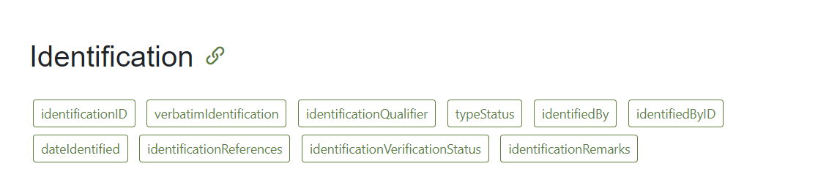
Measuring taxonomic uncertainty
If you work with data from GBIF or other databases that follow the DWC standards, some columns may indicate the quality of the identification
https://dwc.tdwg.org/terms/#identification

Slide 25
Measuring taxonomic uncertainty
Consequences (Vogel Ely et al., 2017, J. Nat. Conserv.)
Overestimating or underestimating of species richness
Compromising understanding of species turnover and ecological gradients
Species loss in synonymization (loss of its recognition as a distinct taxonomic entity)
Erroneous assessments of conservation status, preventing the effective implementation of legislation
Serious implications for endangered species

Slide 26
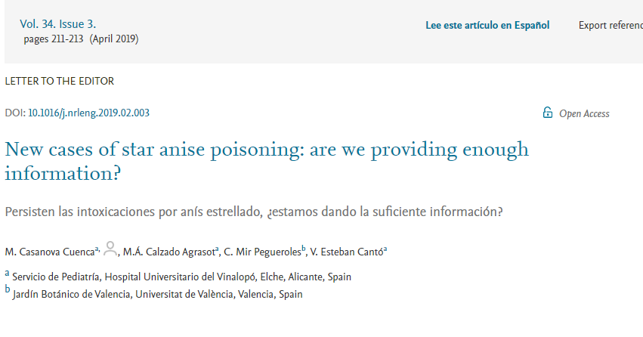
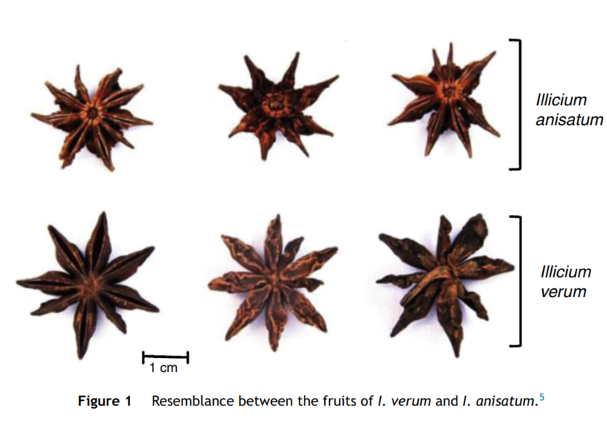
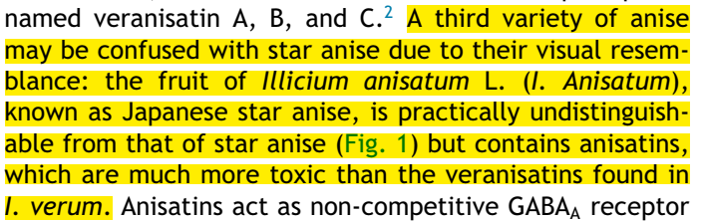
Measuring taxonomic uncertainty

Slide 27
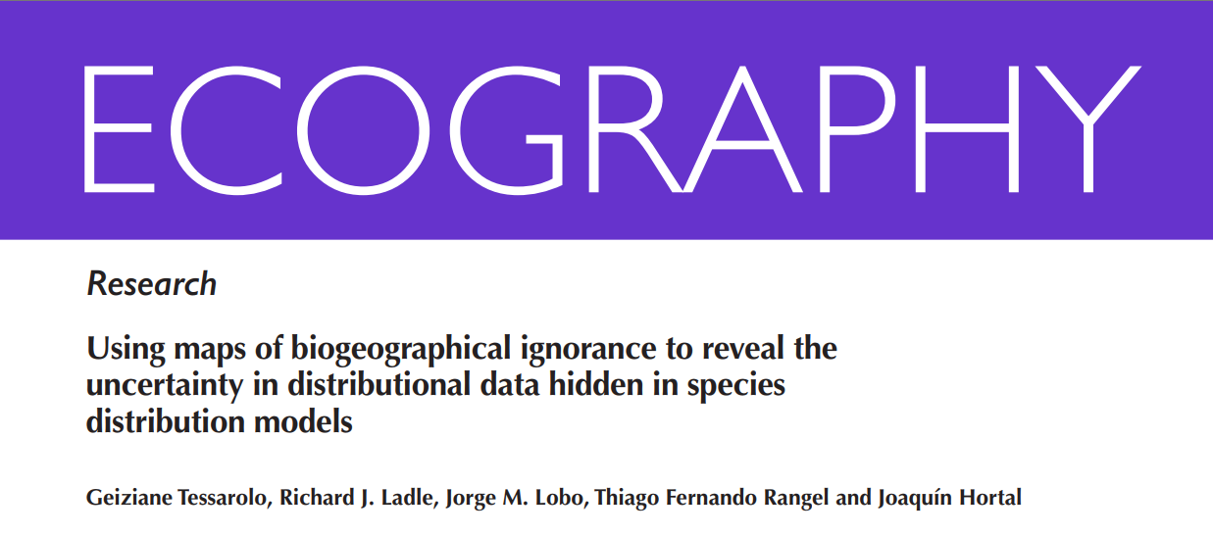
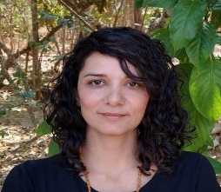
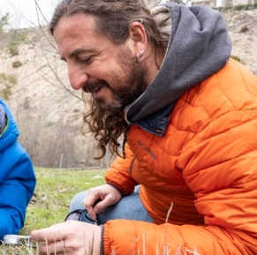
Measuring taxonomic uncertainty
Geiziane Tessarolo
Joaquín Hortal
The taxonomic quality can be estimated by assigning weights according to the expertise of identifier.
Taxonomist = 1.0
Expert = 0.9
Amateur = 0.75
Notes:
The taxonomic quality of all records in the database can also be estimated by assigning weights according to the expertise of identifier (Tessarolo et al., 2021 Ecography):

Slide 28
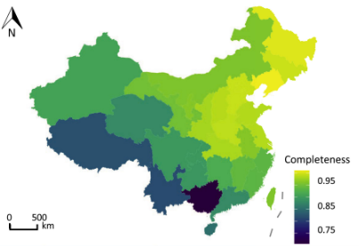
Inventory completeness
A measure of how well a biological inventory captures all present species in a given location or region
Survey/Sampling effort
Important to biodiversity
studies, conservation,
and environmental
monitoring,
as it directly affects
the interpretation of data
Lu et al., 2021 Ecol Evol

Slide 29
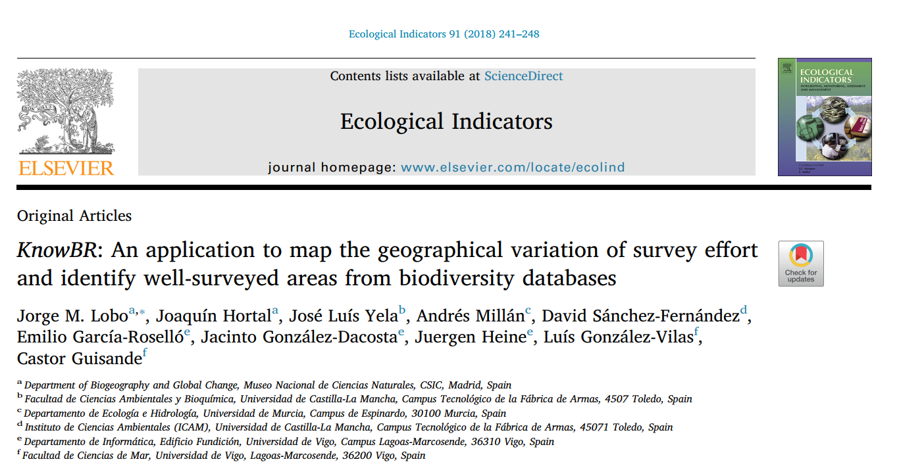


KnowBR
Jorge M. Lobo
Castor Guisande
App designed to simultaneously estimate the completeness of species inventories across a territory
It calculates accumulation curve in each spatial unit within a given territory
It allows identifying those spatial units that can be considered well surveyed

Slide 30
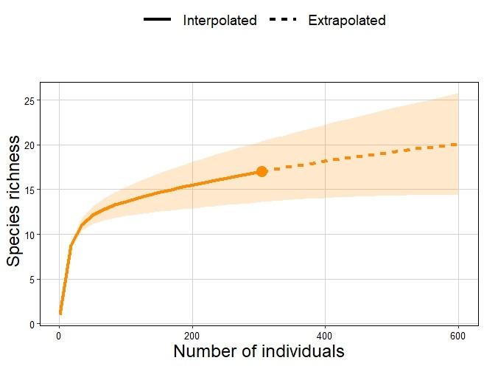
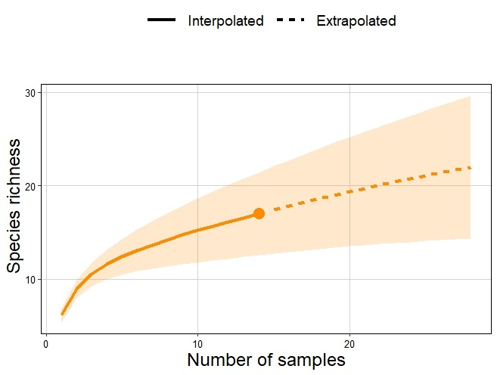
KnowBR: Species accumulation curves (SACs)
Describe the relationship between the accumulated number of species and the survey effort
Characterize the rate of increase with survey effort in each spatial unit
In KnowBR, SACs are adjusted to four different species-accumulation functions
Michaelis-Menten (Clench option)
Negative exponential (N-exponential option)
Classic sigmoid saturation (saturation option)
Rational function
Modified from the book “Análises Ecológicas no R”

Slide 31
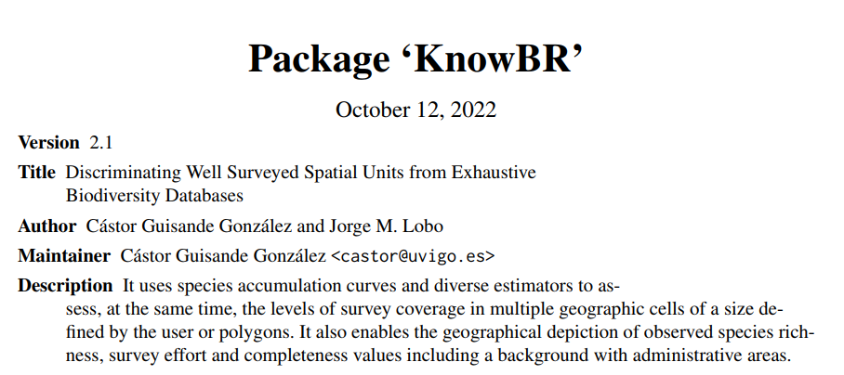
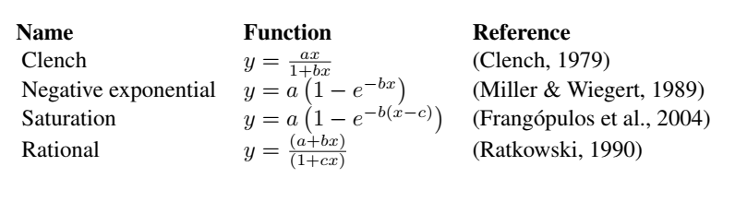
KnowBR: Species accumulation curves (SACs)
Michaelis-Menten (Clench option): produces better results at coarser spatial resolutions (Hortal et al., 2004 Ecography)
Negative exponential (N-exponential option): proposed for rare plant species
Classic sigmoid saturation (saturation option): used to show the relationship between growth of phytoplankton, a toxic algae of the genus Alexandrium and the concentration of phosphate
Rational function: an be used when there is no clear criterion which model to use

Slide 32
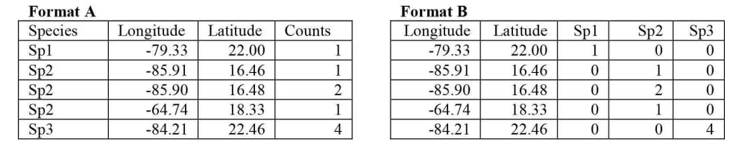
KnowBR: Data entry formats
Long format
Wide format
Caveat: Small numbers of records may present artefactually high completeness
percentages (Stropp et al., GEB 2016)

Slide 33
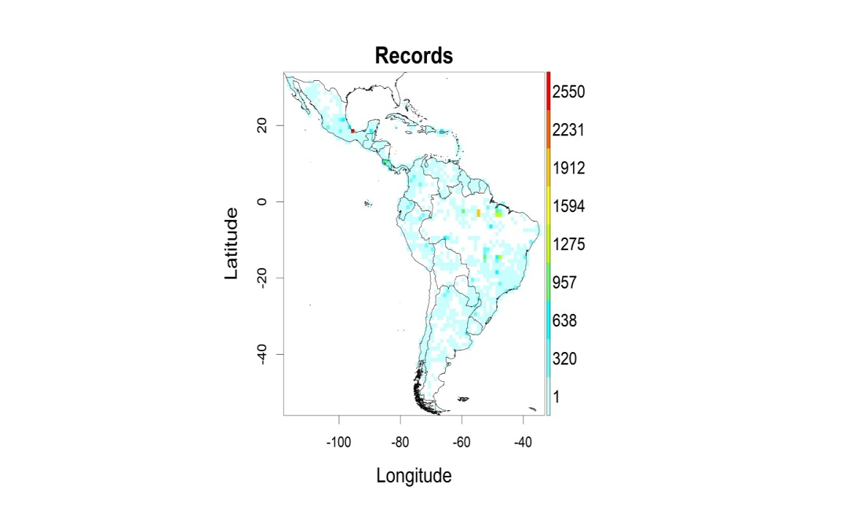
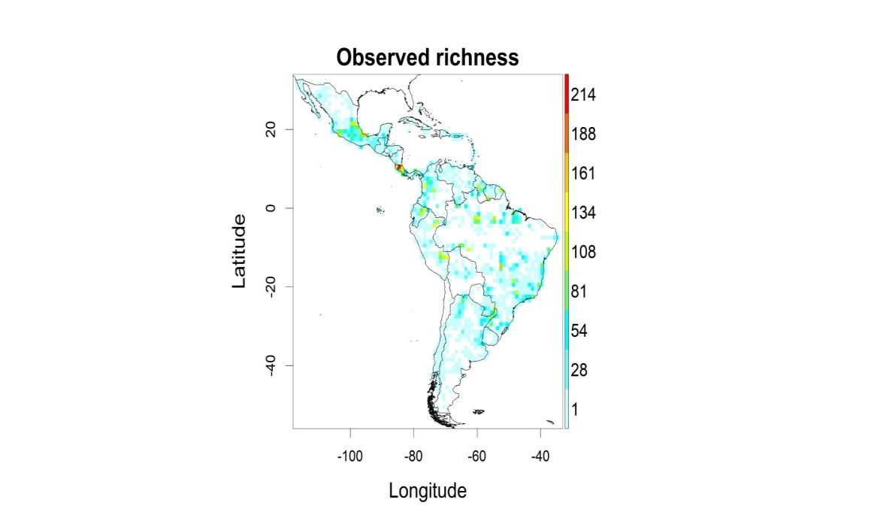
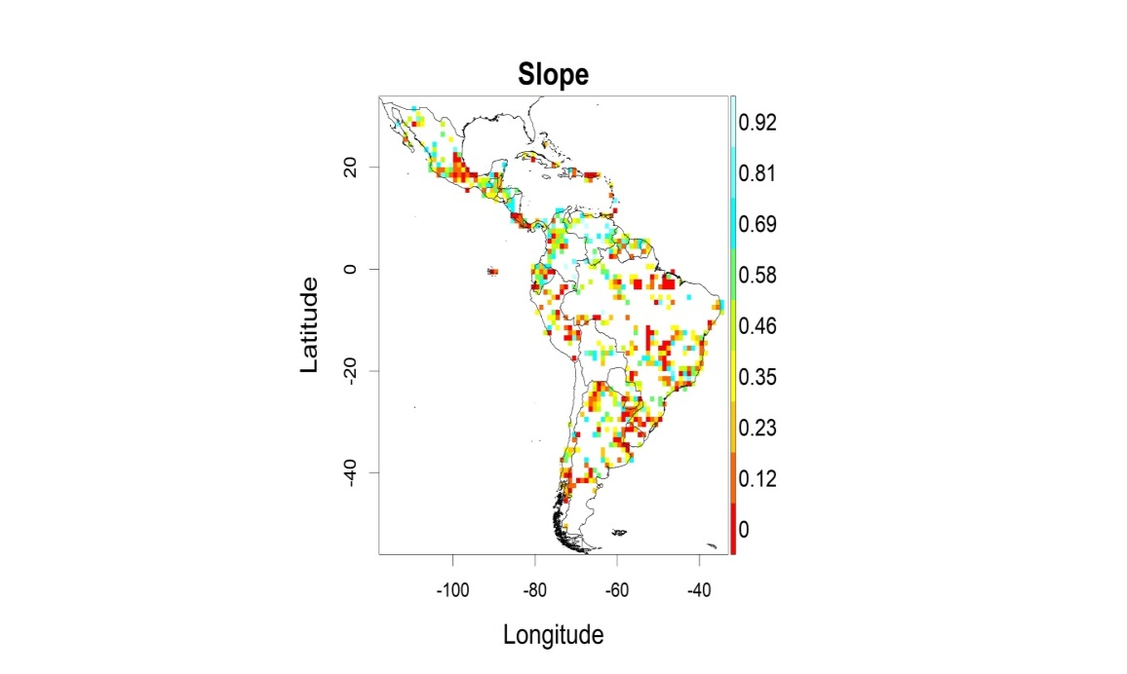
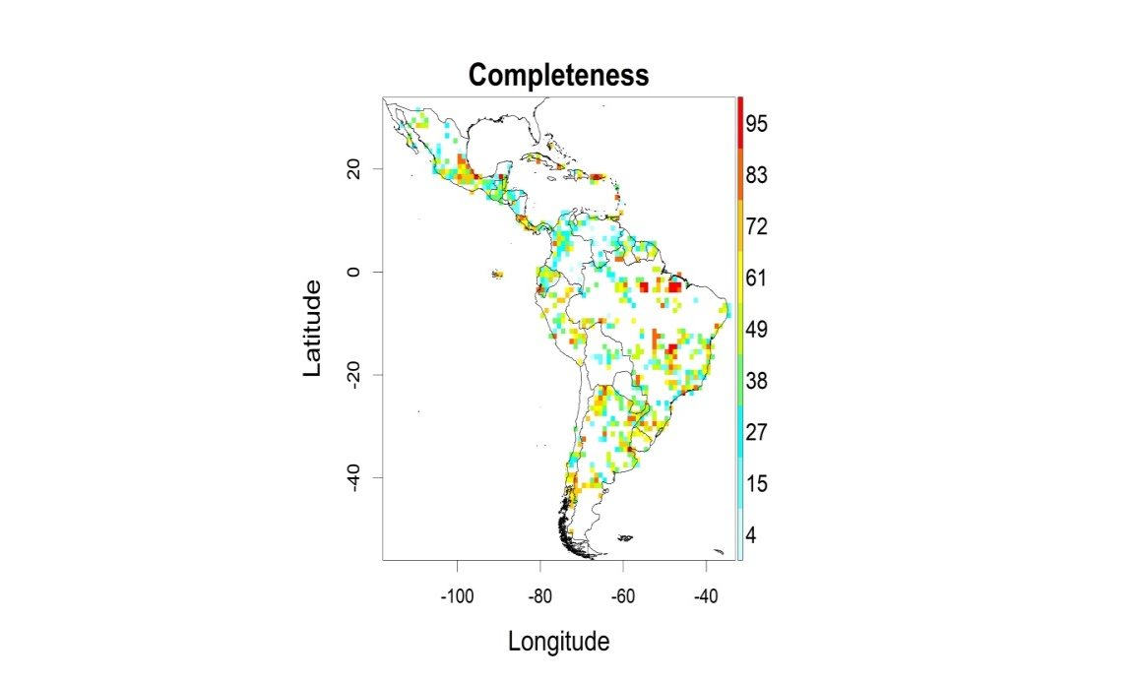
KnowBR: Outputs

Slide 34
References
Isaac, N.J.B., Purvis, A., 2004. The “species problem” and testing macroevolutionary hypotheses. Divers Distrib 10, 275–281. https://doi.org/10.1111/j.1366-9516.2004.00092.x
Lobo, J.M., Hortal, J., Yela, J.L., Millán, A., Sánchez-Fernández, D., García-Roselló, E., González-Dacosta, J., Heine, J., González-Vilas, L., Guisande, C., 2018. KnowBR: An application to map the geographical variation of survey effort and identify well-surveyed areas from biodiversity databases. Ecological Indicators 91, 241–248. https://doi.org/10.1016/j.ecolind.2018.03.077
Lu, M., Gao, L., Li, H., He, F., 2021. The patterns of vascular plant discoveries in China. Ecol Evol 11, 12378–12388. https://doi.org/10.1002/ece3.7971
Pelayo-Villamil, P., Guisande, C., Manjarrés-Hernández, A., Jiménez, L.F., Granado-Lorencio, C., García-Roselló, E., González-Dacosta, J., Heine, J., González-Vilas, L., Lobo, J.M., 2018. Completeness of national freshwater fish species inventories around the world. Biodivers Conserv 27, 3807–3817. https://doi.org/10.1007/s10531-018-1630-y
Stropp, J., Ladle, R. J., M. Malhado, A. C., Hortal, J., Gaffuri, J., H. Temperley, W., Olav Skøien, J., & Mayaux, P. (2016). Mapping ignorance: 300 years of collecting flowering plants in Africa: 300 Years of collecting flowering plants in Africa. Global Ecology and Biogeography, 25(9), 1085–1096. https://doi.org/10.1111/geb.12468
Tessarolo, G., Ladle, R.J., Lobo, J.M., Rangel, T.F., Hortal, J., 2021. Using maps of biogeographical ignorance to reveal the uncertainty in distributional data hidden in species distribution models. Ecography 44, 1743–1755. https://doi.org/10.1111/ecog.05793
Vogel Ely, C., Bordignon, S.A.D.L., Trevisan, R., Boldrini, I.I., 2017. Implications of poor taxonomy in conservation. Journal for Nature Conservation 36, 10–13. https://doi.org/10.1016/j.jnc.2017.01.003

Slide 35

Organizers: Fernanda Alves-Martins Javier Martinez-Arribas Thainá Lessa
Workshop
Using OpenRefine for pre-processing ecological data

Slide 36
Principal features
Free desktop application that uses your web browser.
Does not modify your dataset.
Save as you go.
Can reply cleaning steps on multiple projects.
Provides overviews of the dataset and helps resolve inconsistencies.
For small to mid-size datasets (< 50k).
Notes:
the choice of the type of data used in each study depends on:
– (a) the quality and quantity of available data
– (b) the purpose of the study

Slide 37

Installation
Go to https://openrefine.org/download
Download and unzip the installation file. (Maybe you want to install java manually before from https://adoptium.net/es/temurin/releases/)
Notes:
A mais importante dessas iniciativas é, sem dúvida, o Global Biodiversity Information Facility (GBIF), iniciado em 2001 (Edwards, 2004). O GBIF aproveita os esforços coordenados e contínuos de longo prazo para digitalizar espécimes das coleções de história natural do mundo (Nelson & Ellis, 2019).
De acordo com a maioria das medidas, o GBIF tem sido um sucesso notável e atualmente hospeda mais de dois bilhões de registros de ocorrência de espécies de mais de mil instituições (GBIF, 2022).
O GBIF é uma rede internacional e infraestrutura de pesquisa que fornece acesso aberto a dados de biodiversidade. O GBIF foi criado em resposta à recomendação do Megascience Forum da OCDE em 1999 e, desde a sua criação em 2001, cresceu para incluir mais de 1 bilhão de registros de ocorrência de espécies e 41.000 conjuntos de dados. O GBIF é relevante para as metas de Aichi, pois o crescimento no número de registros é um indicador do BIP (metas 9,11,12,13 e 19). Globalmente, conforme observado por (Bingham, et al., 2017) e o BIP (2018), aumentar as conexões entre as diferentes plataformas de informação e organizações a nível global será importante para melhorar a capacidade de recolha de dados e a sua utilização no rastreamento progresso rumo ao quadro pós-2020, a nível internacional e nacional.

Slide 38

Creating a project
First of all we will have to select the file where our data is located:

Slide 39

Creating a project
When a preview of the data appears, we will add the name of the project, the type of parsing, the encoding (UTF8), unselect "store blank rows" and press the button to create project.

Slide 40

Data processing
Changing column names. The column dropdown menu:

Slide 41

Data processing
Outliers and NAs:
Maybe we need to transform the data format first:
Notes:
Temporal:
Além disso, mudanças temporais na cobertura espacial das pesquisas resultam em dados espúrios sobre mudanças nas distribuições ao longo do tempo (Lobo et al. 2007, Hortal et al. 2008), afetando nossa capacidade de identificar mudanças de alcance anteriores (Huisman & Millar 2013) e determinar padrões atuais de extinção (Lobo 2001).

Slide 42

Data processing
And now, looking for the range of values in the transformed feature:
We see that there are values bigger than -16 degrees for latitude feature.
It is necessary to filter out values smaller than -29 or bigger than -16 degrees.
Notes:
The accuracy of any analysis or prediction depends on the quality of the original data.
These decays account for the progressive loss of value of data to predict biodiversity trends at increasing distance from the observations
The decay of biological information with time and space comes about because species are continuously responding to ongoing environmental changes. Changes over time include climate change, land-use change, habitat degradation, and biological invasions
Changes in space include climate, habitat type, soil chemistry, level of disturbance, and community composition.
Taxonomic:
Many groups and species receive more studies and investments than others
Changes in the taxonomic process and incorrect taxonomic identification
Space:
Some regions or habitats are more sampled than others
Lack of knowledge about species geographic range
Impediment to make reliable previsions on species distribution modelling
Temporal:
Large part of data is out of date
Habitat degradation, changes in land cover and climate changes tend to modify species assemblages

Slide 43

Data processing
And make the same for the longitude values. Filtering out values smaller than 10 and bigger than 25 degrees using a facet as well:
Finally as you can see we discard 8 samples.
With facets menu we can find outliers and NAs, and filter out them as easy as moving the range of values over the plot.

Slide 44

Data processing
Mispelling and text transformations:
One of the most powerful tool of OpenRefine is how it can deal with spelling errors. Before starting, it is a good practice triming leading and trailing whitespaces, collapse consecutive whitespaces and coverting to lowercase all text columns.

Slide 45

Data processing
In order to deal with spelling errors we have inside the text facet menu, the cluster button:

Slide 46

Data processing
You can test with the two methods available, “Key collision” and “Nearest neighbor”, and even tune its hyperparameters:

Slide 47

Data processing
Sometimes we need to split a text column in several different columns:
Notes:
Trained taxonomists
Experts
Amateurs

Slide 48

Data processing
Select the separator by which we are going to divide the column and accept:

Slide 49

Data processing
Remember that we can come back and undo all changes that we want just going to the Undo/Redo tab:

Slide 50

Data processing
In this tab we have the “Extract” button in order to apply (“Apply” button) all the changes that we have done to other files or datasets. (p.e: smaller splits of the big dataset):

Slide 51

Data processing
For filtering, there exist several methods:
Text filter menu.
Text facet / numeric facet >> include / exclude value.
Custom facet.

Slide 52

Data processing
For sortering we can use the sort option inside the dropdown menu:
We can chose putting errors and blanks at the beginning in order to edit them easily.

Slide 53

Data processing
Exporting the final result is as simple as pressing the ”Export” button and select the option that you prefer:
With OpenRefine you can share both the final dataset and all processing steps.

Slide 54
Fernanda Martins - ferfealvesmartins@gmail.com Javier Martínez - javimartinezarribas@gmail.com Thainá Lessa - thainalessaps@gmail.com
Thank you!
Merci!
Murakoze!
¡Gracias!
Obrigado!

